Slide 1

Applicant Data TEACHERS COLLEGE
7 Relational Databases | Over 45 Features/Variables | Over 200k records
Shreya Goel
Notes:
This is the report based on Applicants Data from Teachers College.
[[ Data Set Related Details:
CSV File format
Raw data
7 Relational Databases | Over 45 Features/Variables | Over 200k records
4.5 k applicants | Over 4.5 k applications
Applicants who did not show up at TC when offered admissions over a period of X years (omitted for several reasons) and Y semesters ( Y > 2.5X)
Login Data: over 120 k records | Message Data: Over 65 k | Other 5 datasets: Application Data, Application Decision, GRE, Event Data, School data: Over 45 k data points
-- For descriptive analysis, many features were engineered so as to gain better understanding of trends and insights. Data was cleaned, using various techniques. Null values were treated with due care. Based on normal range of the feature, one outlier was converted to null for that particular feature, considering it was either a typing error or a dummy value.
Since my analysis focused on logins and messages history over time, many new variables were generated such that they could be utilized better. ]]

Slide 2
Applicant Data Buckets
All Applicants
Not Offered Admission
Offered Admission
School Loses this Bucket
(To research on factors that can predict this bucket of students)
Not Enrolled
Deposit
Did Not Deposit
School Final Student Bucket
(Not considering retention in further semesters here)
Enrolled
Notes:
First let's understand the applicants data buckets:
In any higher ed institute applicants data can be divided into the following buckets based on offers and enrolments.
After the initial stage of application submission, the first stage is where the students are either offered admissions or not. The next stage is if the applicants who are offered admissions will enroll and show up or not. But before that, they need to confirm through depositing a small fee about their interest in enrolment, and so 2 further buckets can be added with applicants who deposit the fee and those who don’t.
The data provided here included records of applicants who were offered admissions by the school but did not enroll/show up finally. Some of them deposited the enrollment fee and some of them did not.

Slide 3
Current Research Focus
Build a classification scheme to identify the attributes that distinguish between students who deposit but ultimately don’t enroll and those who never deposited in first place.
Notes:
The current research focus was to build a classification scheme that helps identify and distinguish the attributes of the applicants who deposit the fee but ultimately don’t enroll and those who never deposit in first place.

Slide 4
Initial Analysis
(Facts)
4765 Applications | 4470 Unique Applicants
Notes:
Our initial analysis consisted of records from 4765 applications 4470 unique applicants.

Slide 5
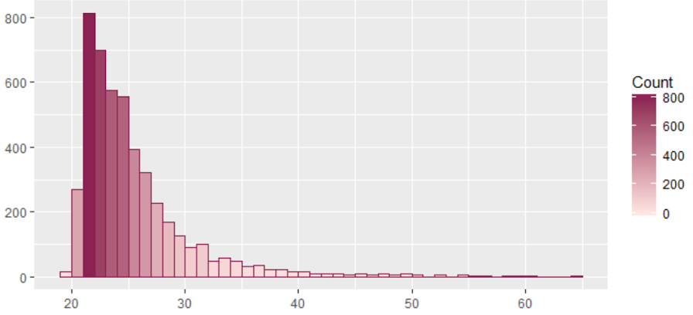
Age Group of Applicants
Number of Applicants
Age
Notes:
Applicants’ Age Ranges between 20 years to 65 years with majority in 21 to 30 years of age

Slide 6
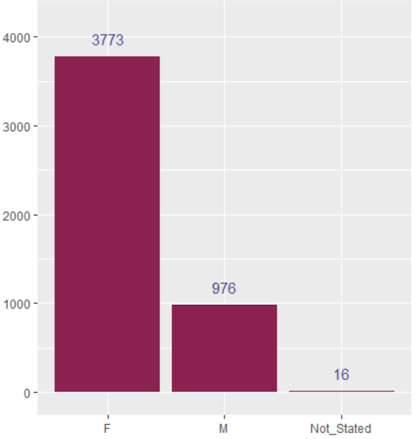
Gender Dominance Amongst Applicants
Number of Applicants
Gender
Notes:
Majorly females apply to Teachers college with 3773 applications recorded in the current data and only 976 Males. There were 16 cases where the applicants also chose to not state their gender.

Slide 7
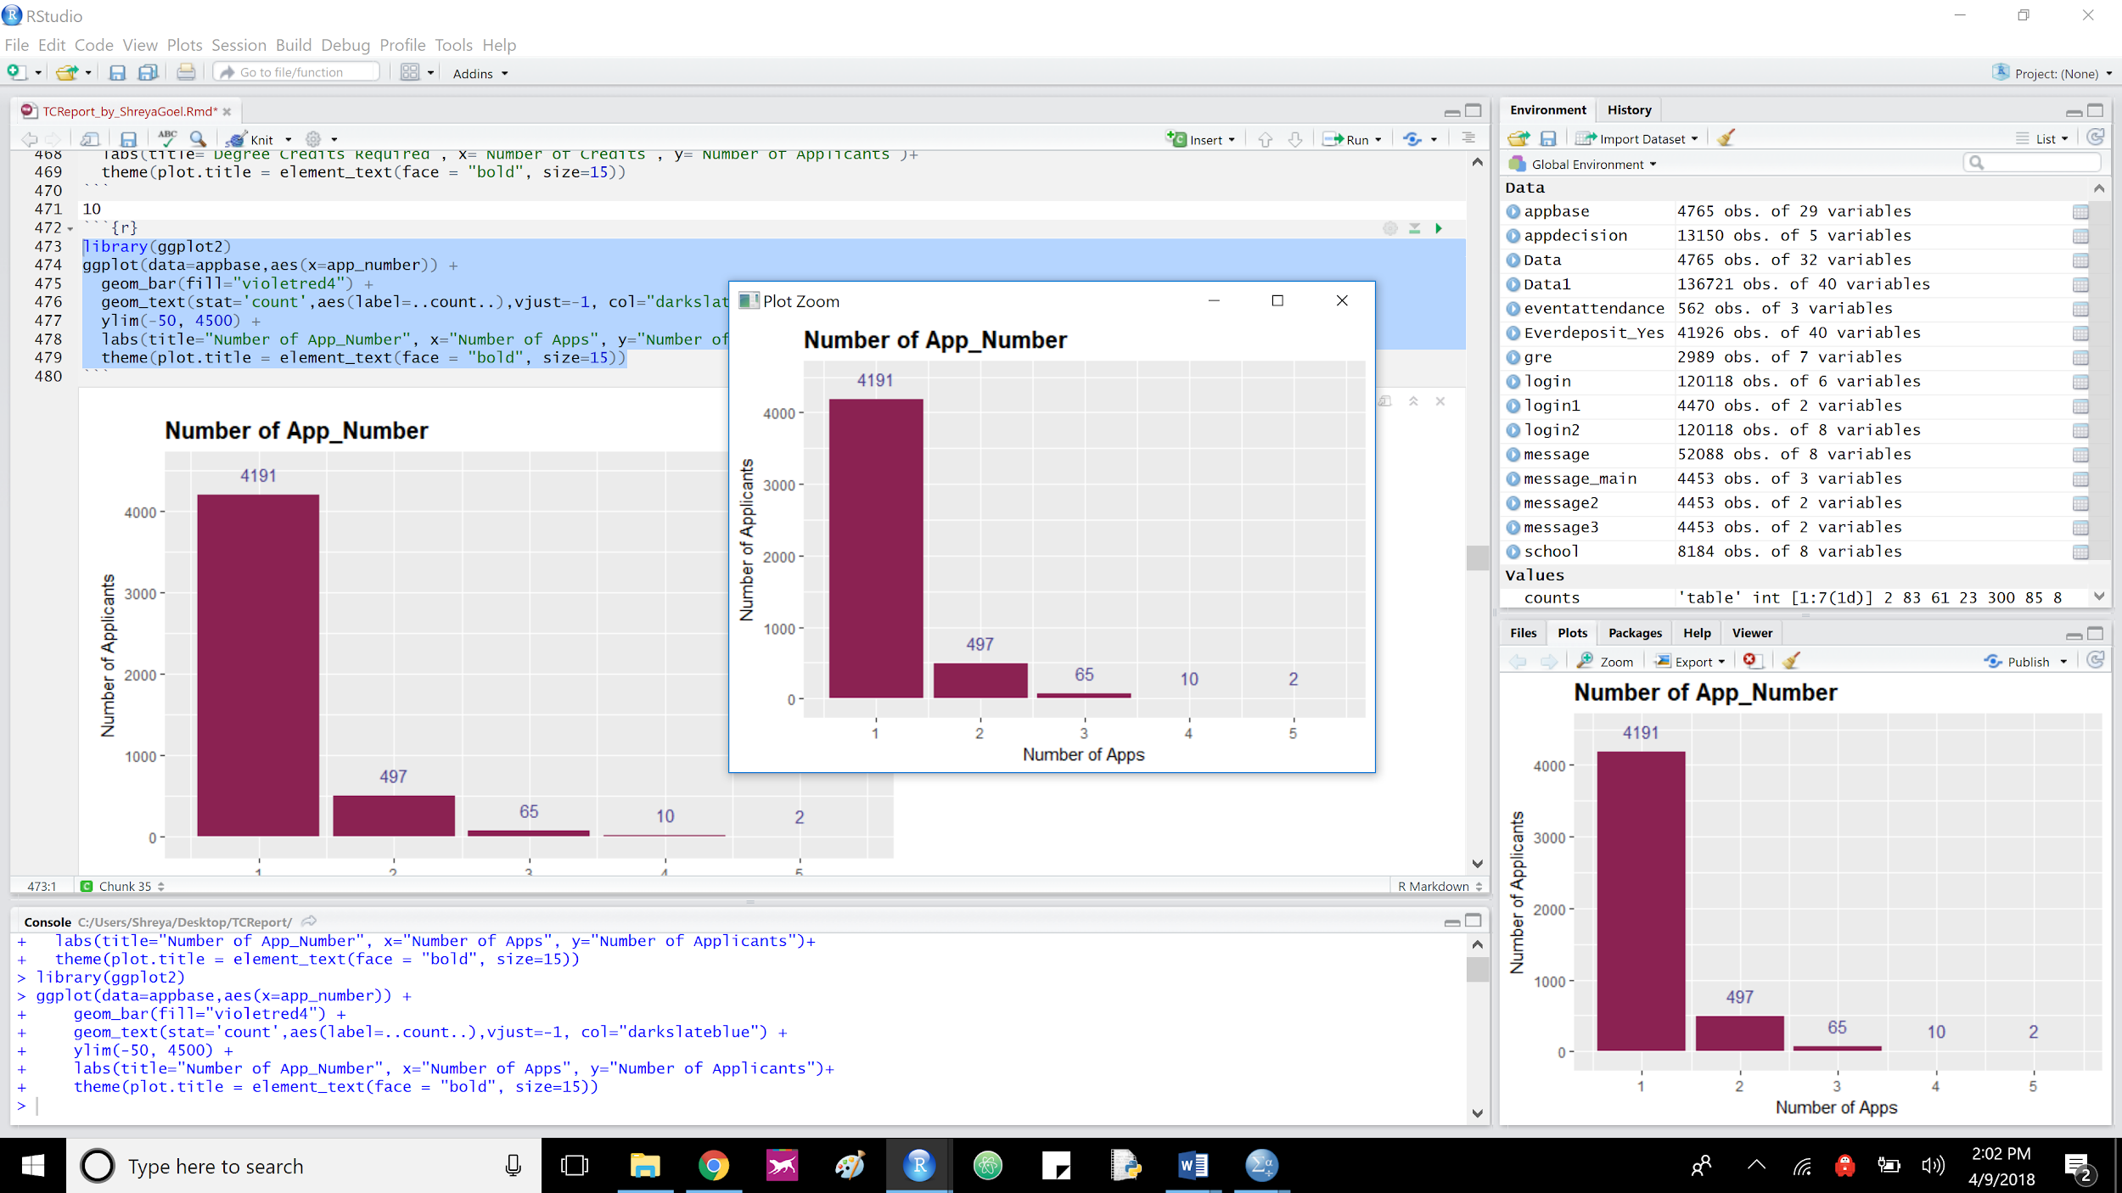
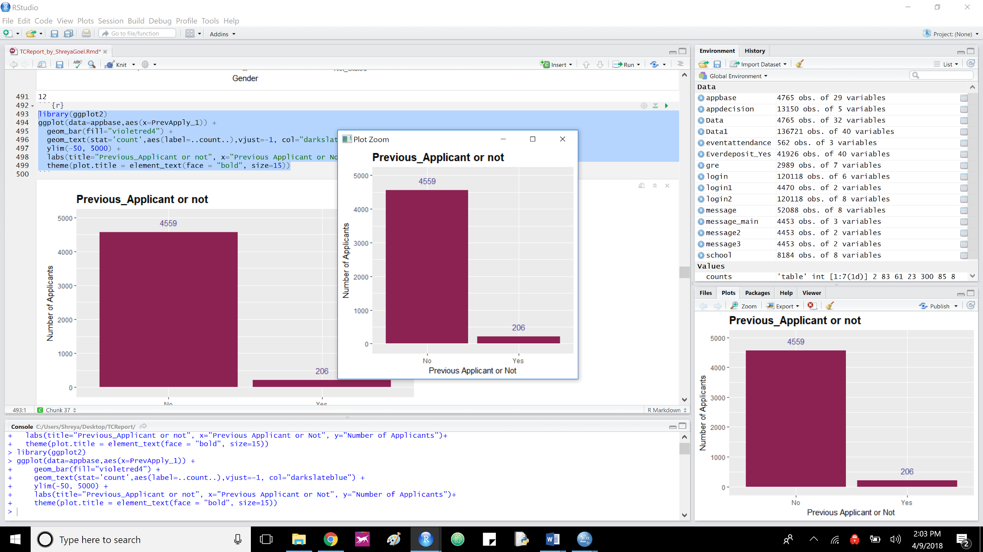
Number of Previous Application
Number of Previous Applications
Number of Previous Applications
Self Reported
Recorded by the system
Notes:
More than 550 cases are repeat applications as recorded by the system, but only 206 of them chose to report the fact that they applied previously.
Moreover, the interesting thing could be what kept these applicants from not enrolling when they were offered admissions on their re-applications.

Slide 8
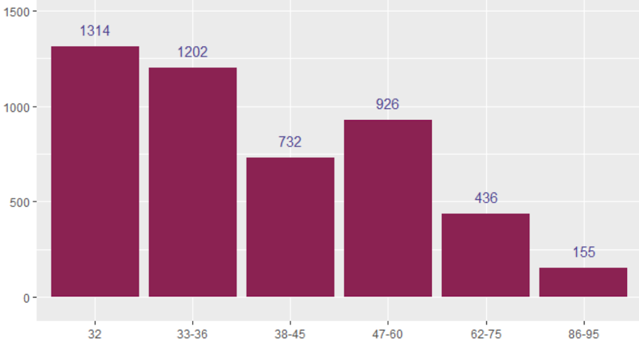
Degree Credits Applied for, by Applicants
Number of Applications
Number of Credits
Notes:
Records included applications with degree credits ranging from 32 to 95 with
32 credits - 1314 applicants
33-36 credits - 1206
38-45 credits - 732
47-60 credits - 926
62-75 credits - 436
86-95 credits - 155

Slide 9
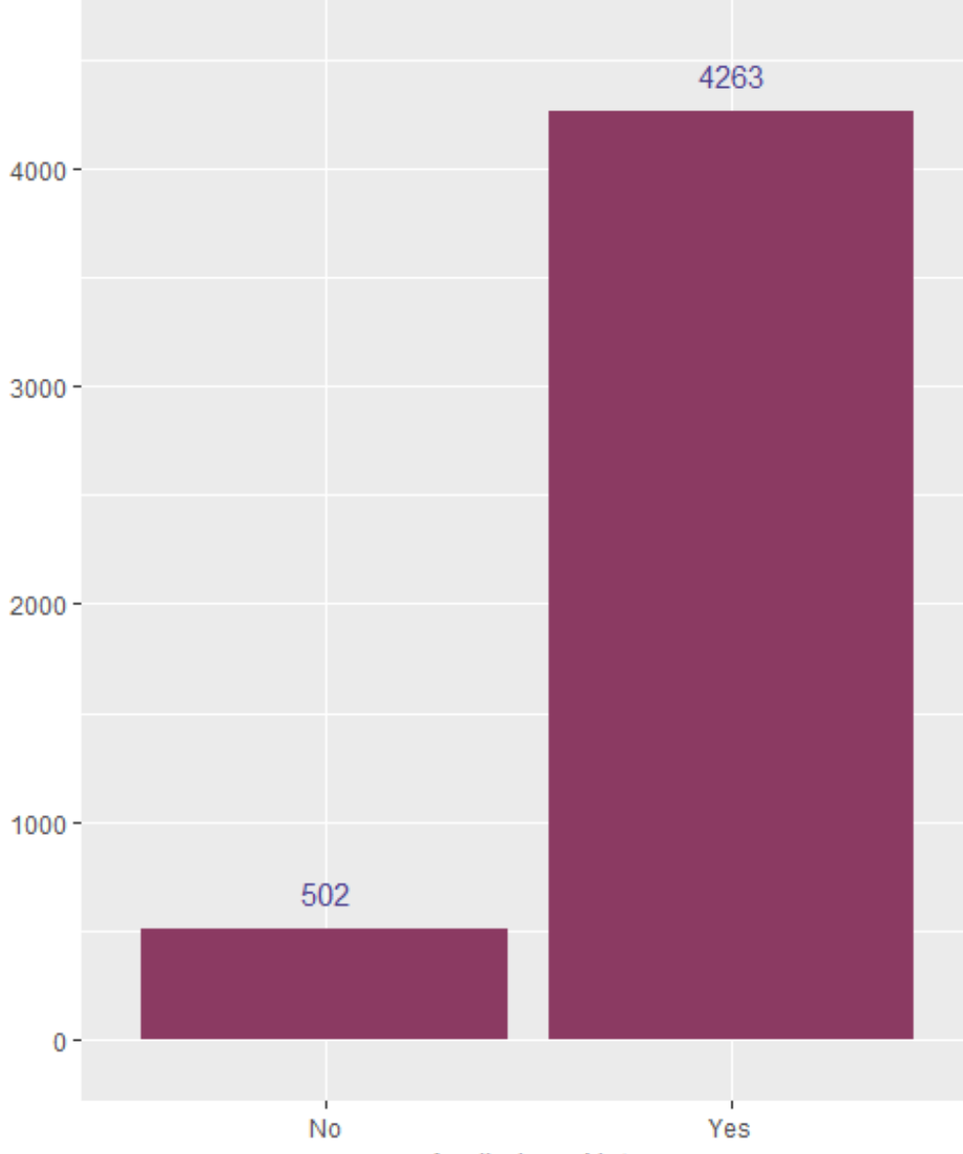
Number of Scholarship Applications
Number of Applications
Yes / No
Notes:
4263 Applicants applied for Scholarship, while 502 did not.

Slide 10
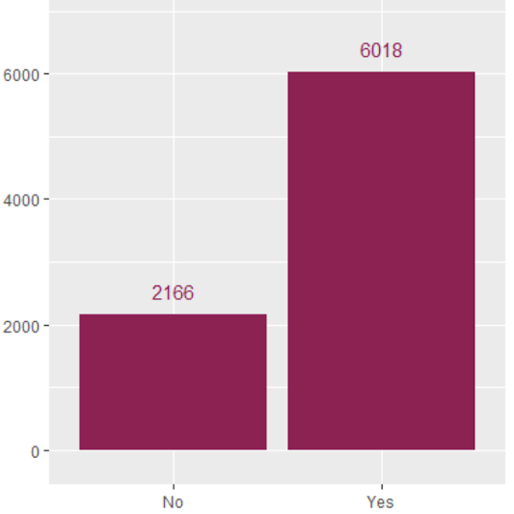
Previous Degree or Not (Dropped) as reported by the Applicants
Number of Applicants
Yes /No
Notes:
Previous School GPA Range - 1.2 to 4.5
With majority between 3 to 4

Slide 11
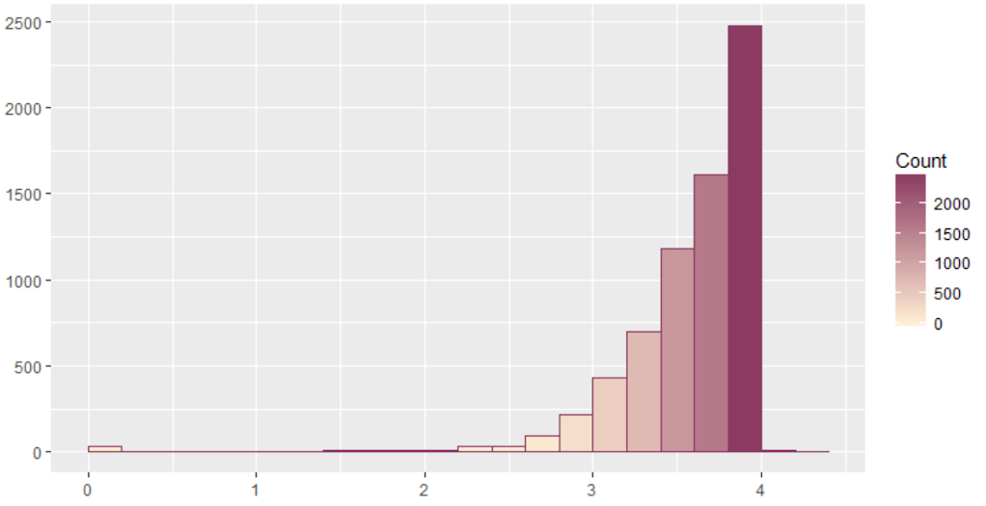
Previous School GPA Scores as reported by the Applicants
Number of Scores recorded
GPA Score Reported
Notes:
Previous School GPA Range - 1.2 to 4.5
With majority between 3 to 4

Slide 12
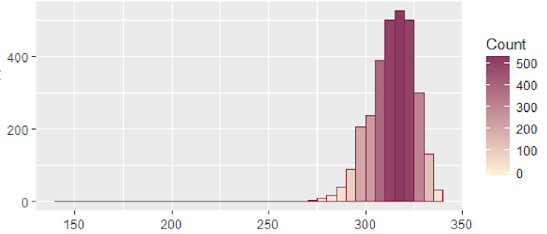
GRE Total Scores as reported by the Applicants
Number of Scores recorded
GRE (Quants + Verbal) Score Reported
Notes:
Individual GRE Verbal and Quantitative Scores are omitted from this report, since it is not one of the requirements in most programs at Teachers College. GRE Scores Total (Verbal+Quants) Ranges between 141 to 340 with majority 305 to 330

Slide 13
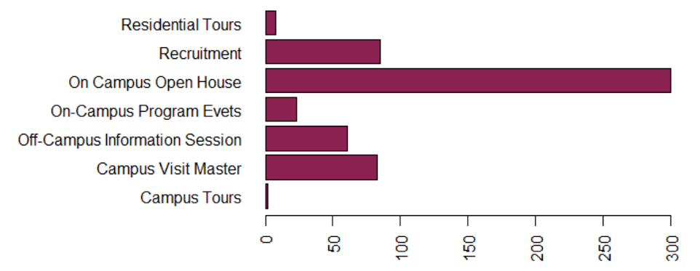
Engagement with Events
Number of Attendees
Notes:
562 event attendances were recorded for 4470 unique applicants on 4765 applications
Further Analysis Tips: select id from event and select id of deposited, sna to check if those who attended deposit more

Slide 14
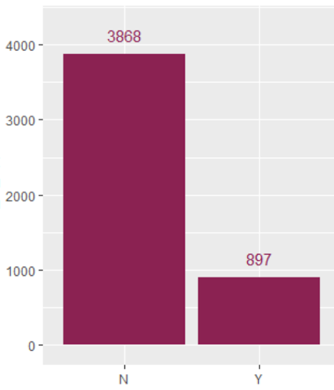
Deposit/Did not Deposit the Entry Fee
Number of Applicants
Deposit / Did not Deposit Entry Fee
Notes:
Out of 4765 applications, 897 applications deposited fee to confirm their arrival/hold their seat and did not show up.

Slide 15
Login and Messages
Deposited & Not Deposited

Slide 16
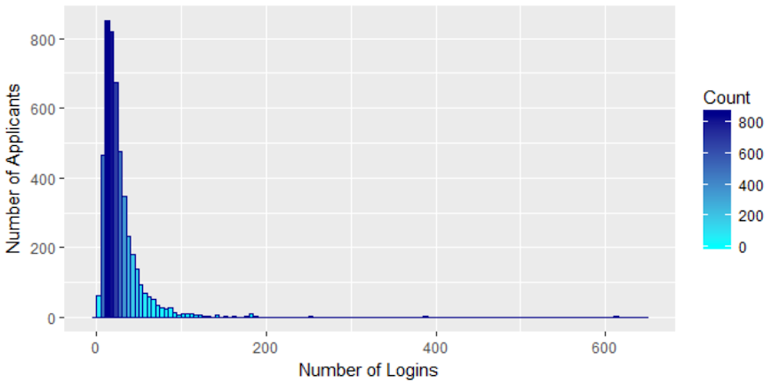
Number of Logins per Applicant
Notes:
Number of Logins per applicant over the period of application

Slide 17
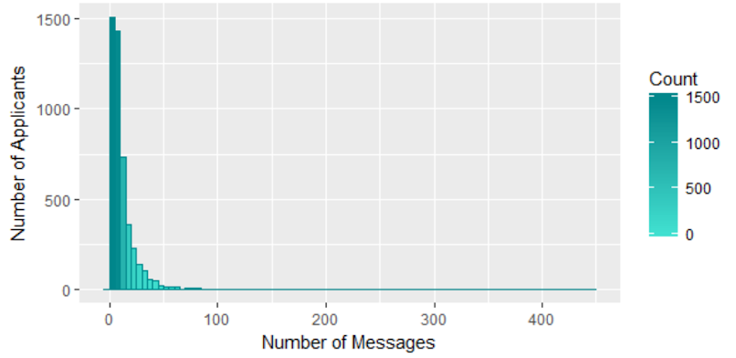
Number of Messages Sent
Notes:
Number of Messages sent by applicant over the period of application

Slide 18
Logins and Messages Data (per Applicant)
Term start date was chosen to be the date from which other dates were subtracted to know about the applicant behavior, certain number of days away from that date.
Time was currently separated and ignored from the analysis.

Slide 19
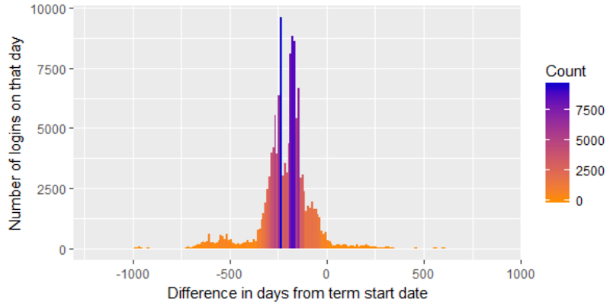
Difference in days from Term Start Date
Notes:
Number of logins on a particular date where 0 is the term start date and -500 is the date where there are 500 days to the term start.
Hypothesis, students using the accounts even after term start and not showing up could be interested in deferring their applications

Slide 20
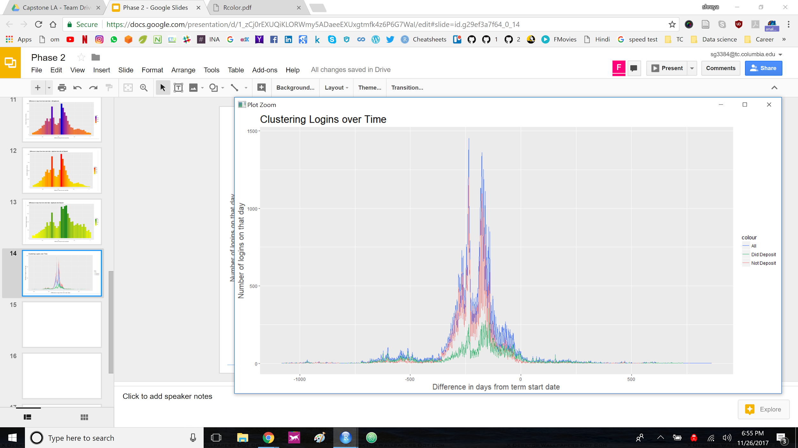
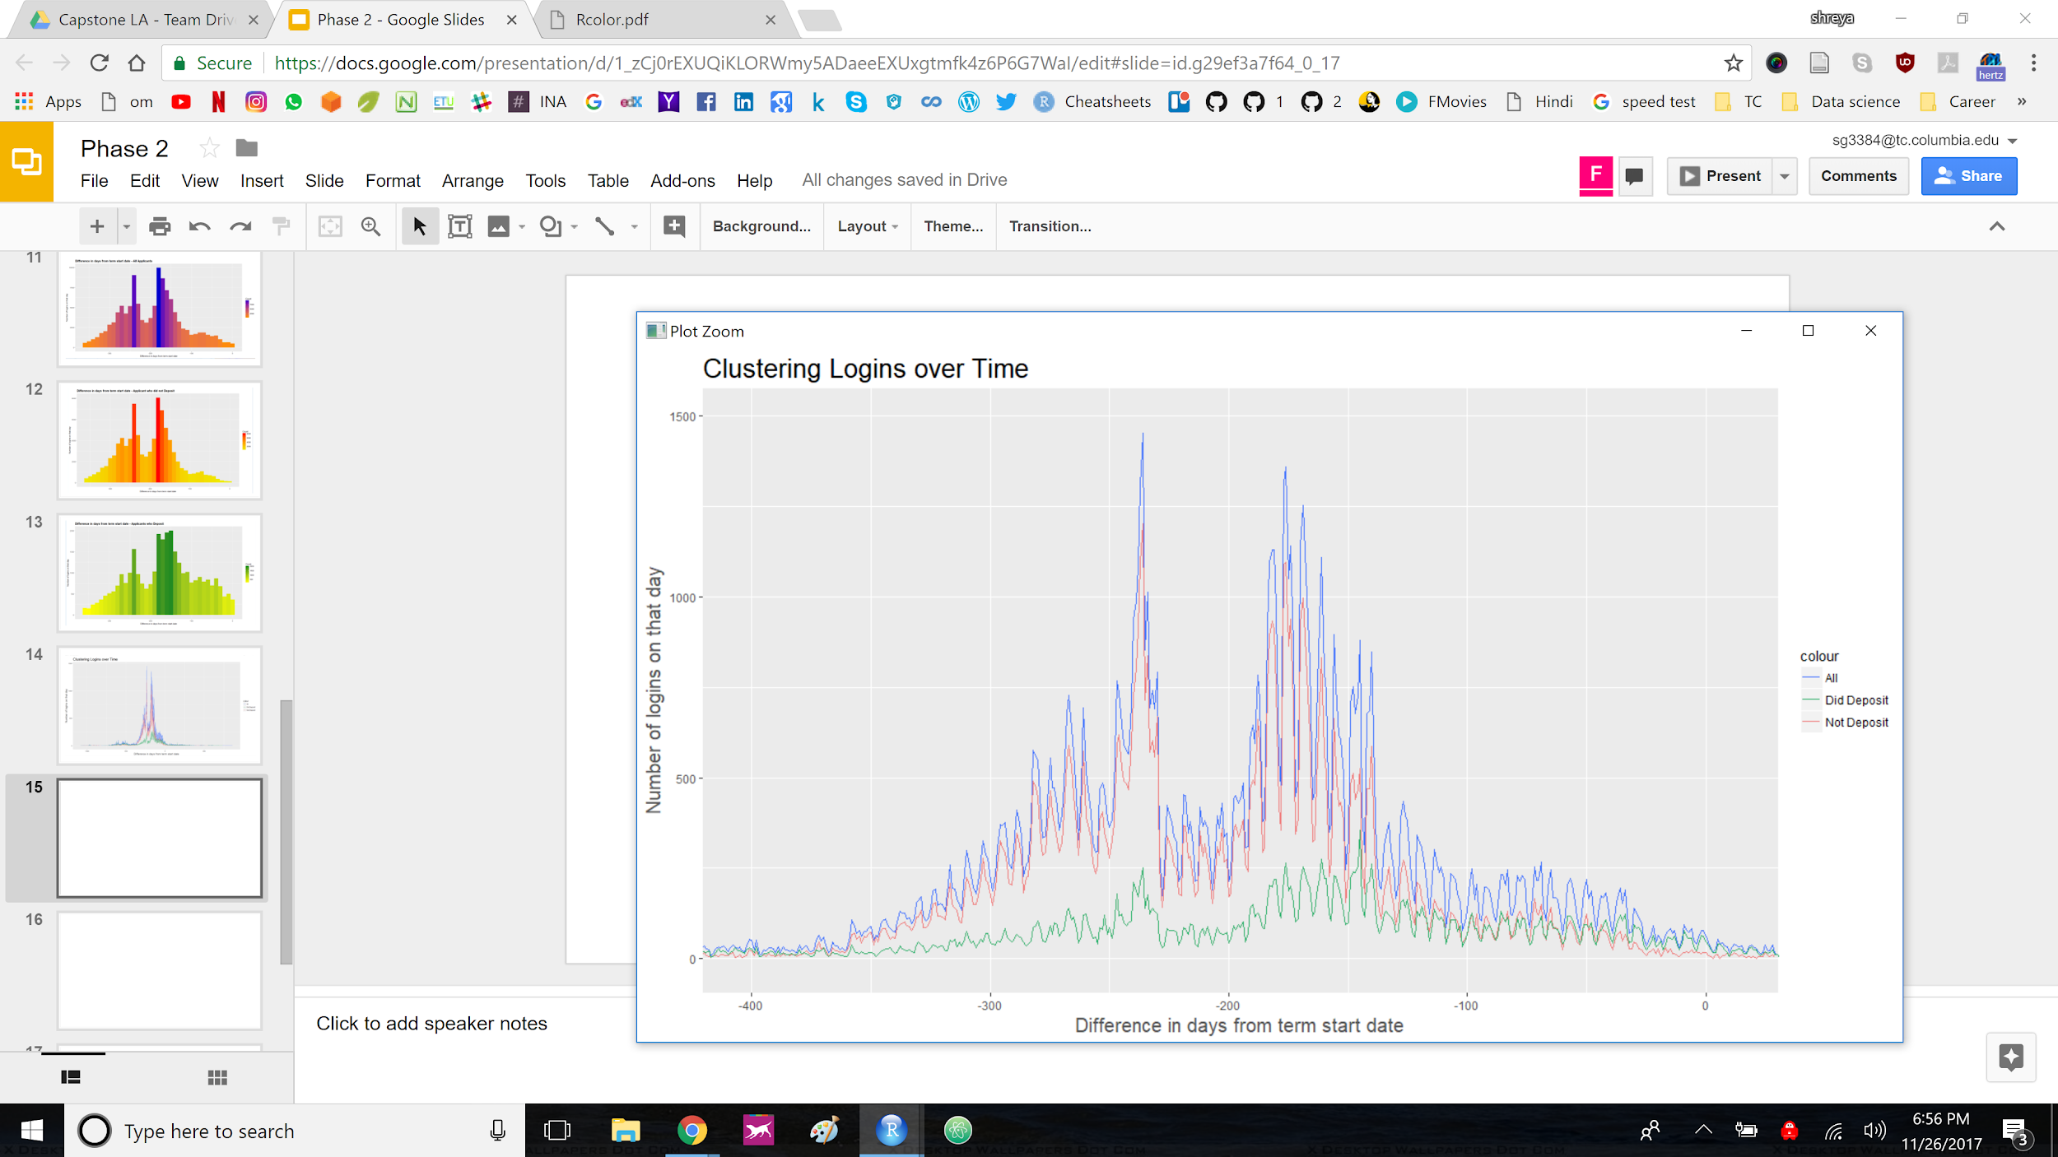
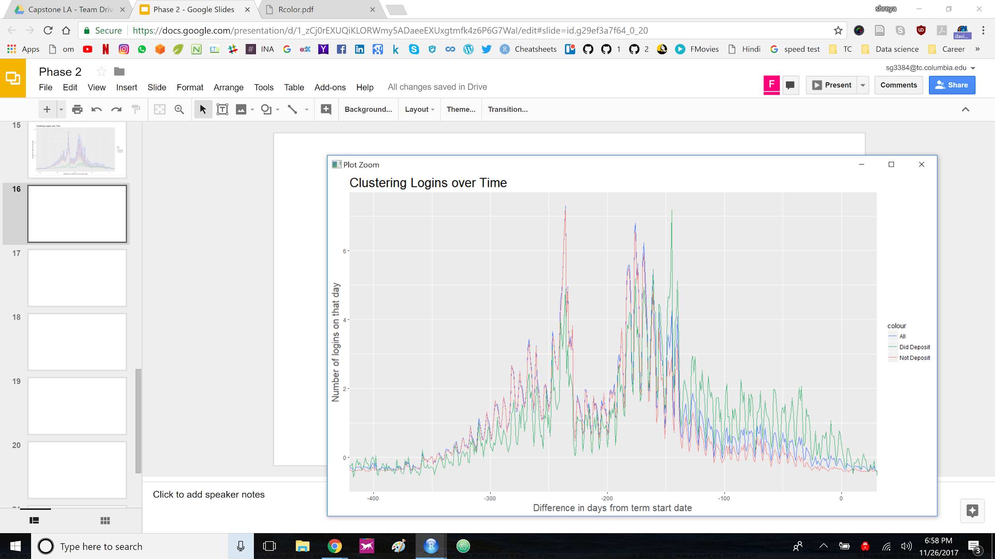
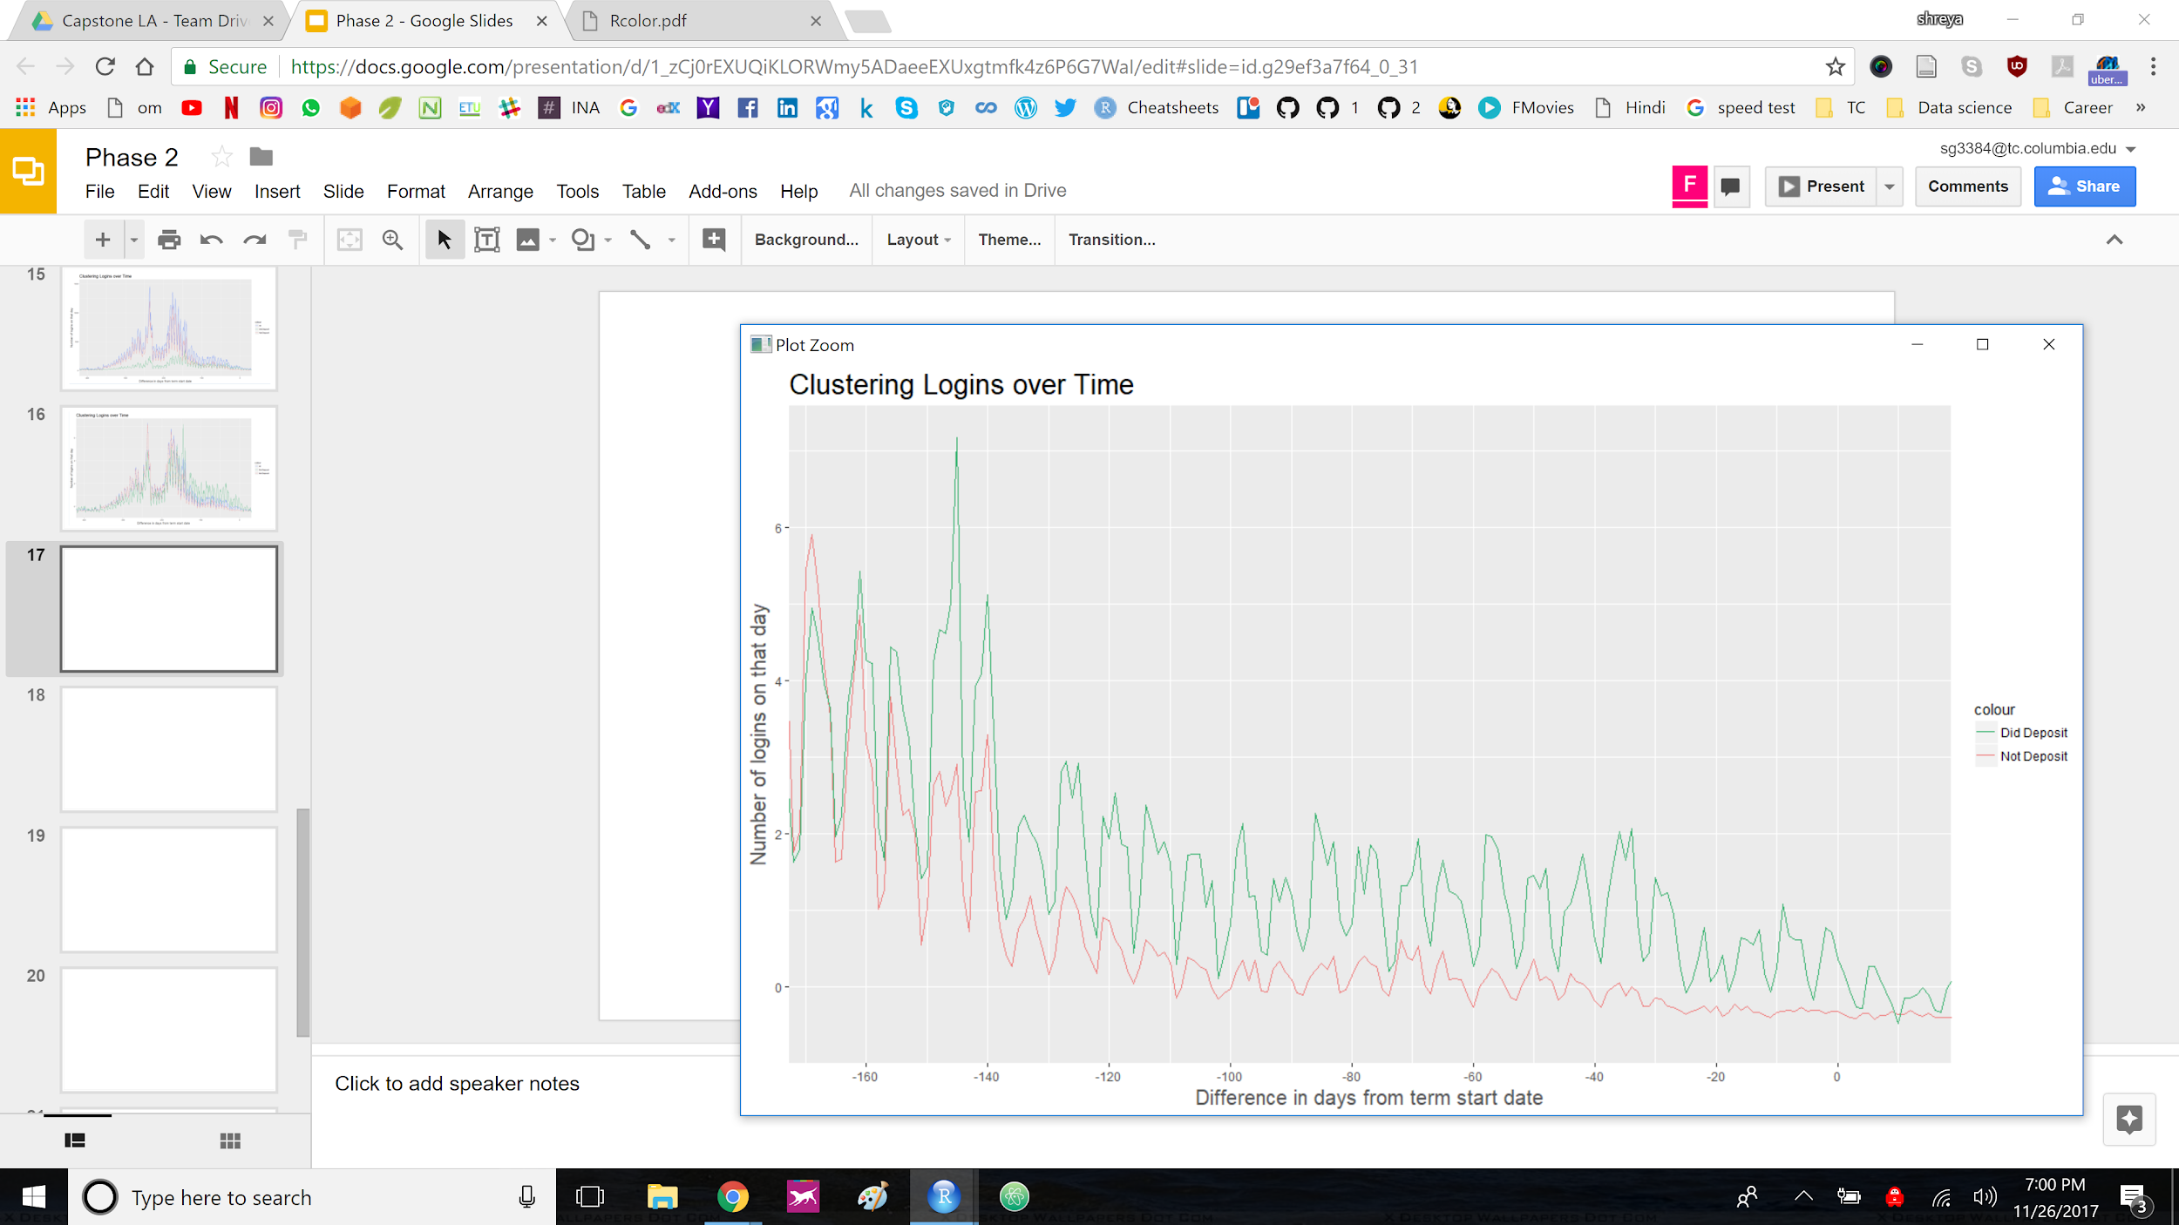
Clustering of Logins over Time
1500
1500
1000
1000
500
500
0
0
-500
0
500
-400
-300
-200
-100
0
Number of Logins on that day
6
6
4
4
2
2
0
0
-400
-300
-200
-100
0
-180
-120
-80
-40
0
Difference in days from term start date
Notes:
This is clustering of logins over time. 3 main colors can be seen throughout in the 4 graphs. Blue is for all the applicants, green is for applicants/applications who deposited the fee while red is for those who did not deposit.
The 2 graphs at the top are unscaled, while the lower two are scaled on a same scale to ease the process of comparison.
If we look closely enough, about 180 days before term start which is time to deposit the fee and confirm your enrollment/interest in TC program, the login activity of the applicants who deposit is different from those who do not deposit.

Slide 21
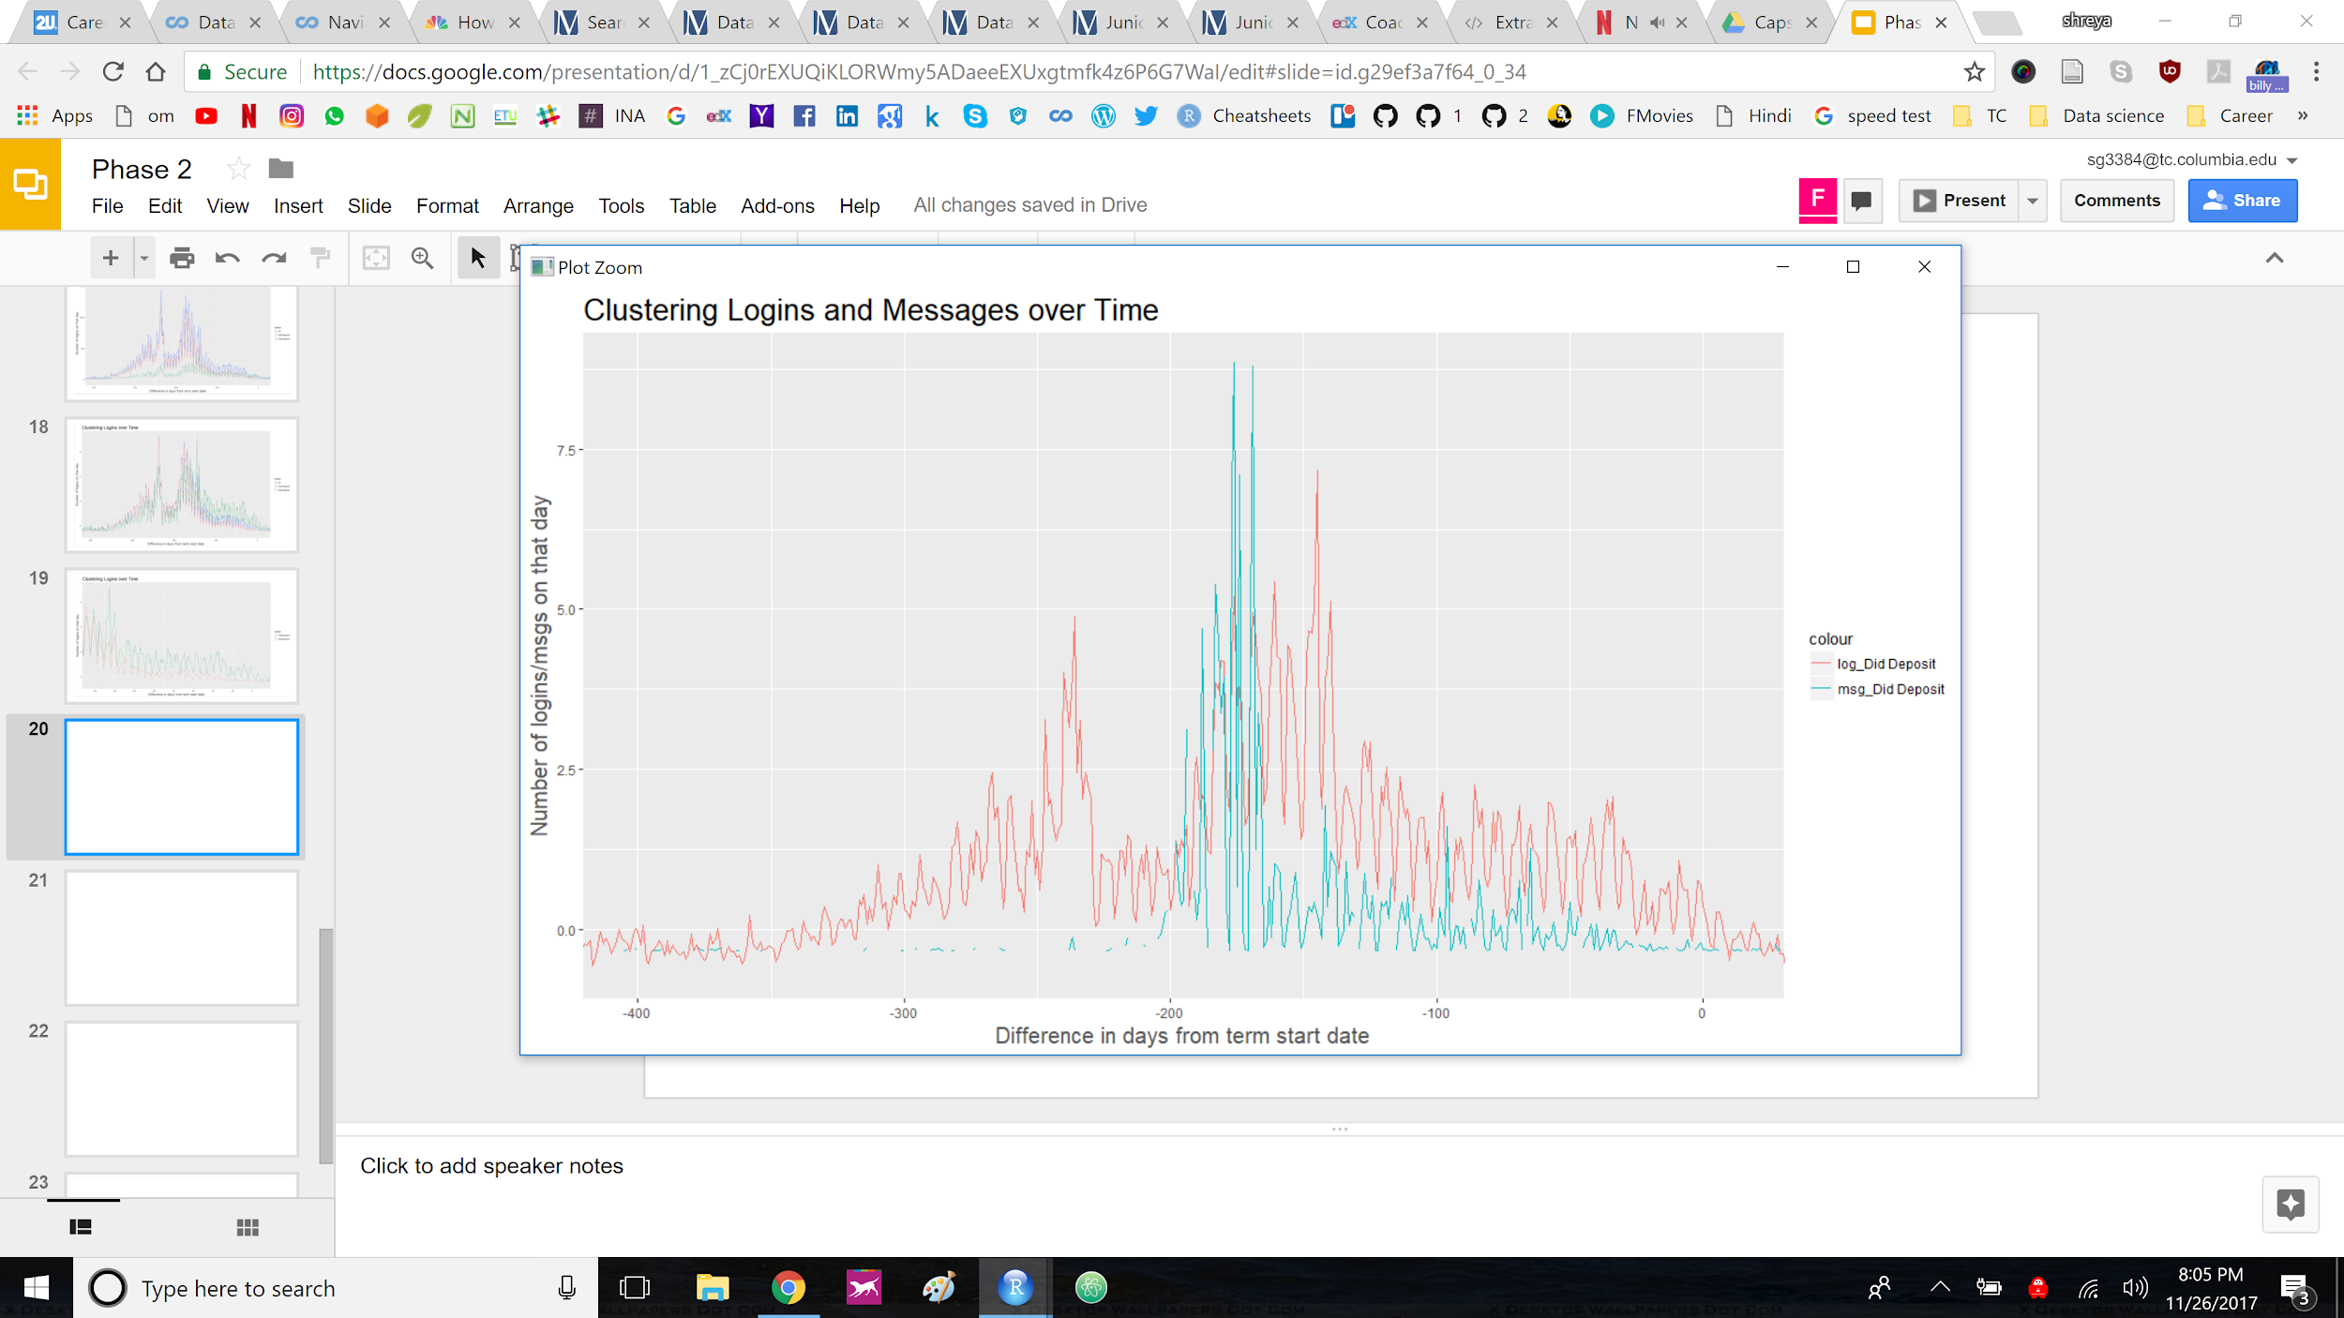
Clustering Logins & Messages over Time (Did Deposit)
Number of messages and logins on a particular day from term start date.
Two major bumps in login activity (red).
Application submission/result
Deposit fee to confirm they are still interested
Bump in message sent by TC- Reminders to deposit fee (blue).
Notes:
To check further, logins and messages were clustered over time for those who deposit and those who do not separately.
In this graph the red line is login history while blue line is message sent history dates. Looking at a period of over 400 days to term start, there are 2 major spikes in number of logins. The first one could be submission of applications/application results and the second one is right after acceptance and deposit due date. Since these students chose to deposit the fee to reserve/hold their seat in the programs after the messages were sent out, this set of applicants show a higher number of login activity after that period.

Slide 22
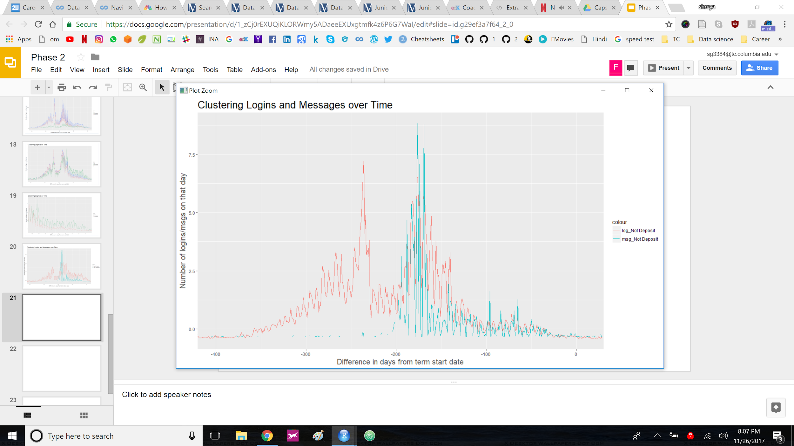
Clustering Logins & Messages over Time (NO Deposit)
Number of messages and logins on a particular day from term start date.
Two major bumps in login activity (red).
Application submission/result
Deposit fee to confirm they are still interested (very less activity as compared to previous one)
Bump in message sent by TC- Reminders to deposit fee (blue).
Notes:
In case of those who do not deposit, Considering the same period of over 400 days to term start, there are 2 major spikes in number of logins. This time the second one is not as big as last time and the login activity is dieing because these applicants choose not to deposit the fee to confirm their seat.

Slide 23
Current Research Focus
Build a classification scheme identifying the attributes that distinguish between students who deposit but ultimately don’t enroll and those who never deposited in first place.
Notes:
The current research focus was to build a classification scheme that helps identify and distinguish the attributes of the applicants who deposit the fee but ultimately don’t enroll and those who never deposit in first place.
Visiting this question again: The applicants who respond to messages starting the 180th day from term start are probably more likely to deposit than the rest.

Slide 24
Recommendations for Future Research
If given access to the complete data pool of applicants, these are some of the ideas I would like to explore:
Were there any particular semesters or years where applicants chose not show up increasingly than the other years, considering the political or financial situation worldwide.
Hierarchical Cluster Analysis
Differentiate behaviour of applicants in different applicant buckets
Predict the applicants who will not enroll if offered admission
Predict the applicants who will not show up after they deposit fee

Slide 25



Thank You Shreya Goel M.S. Learning Analytics | Columbia University Marketing Analytics Intern | Columbia University Mob.: (929) 248-2764 email: shreya.goel@columbia.edu

